Slide 1
Distributive Property
Combo Meal Style…

Slide 2
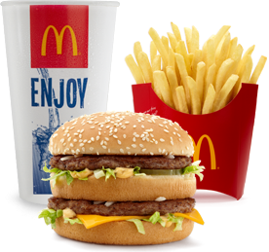
Combo Meal 1:
You get 1 burger, 1 fry, and 1 coke.
b + f + c

Slide 3
Let’s say you want to buy 3 combo meals…
Let: b = burger, f = fry, d = drink
3(b + f + c)
You would get 3 burgers, 3 fries, and 3 cokes.
→ 3b + 3f + 3c
What’s in the combo meal
Number of combo meals

Slide 4
6(3x + 9)
The “combo meal” is 3x + 9. You are ordering six…
How many x do you have?
How many units do you have?
So,
6(3x + 9) = 18x + 54
3x + 9
3x + 9
3x + 9
3x + 9
3x + 9
3x + 9
6(3x) = 18x
6(9) = 54

Slide 5
8(1 + 10a)

Slide 6
8(r - 1)

Slide 7
2(a + 7)

